Slide 1
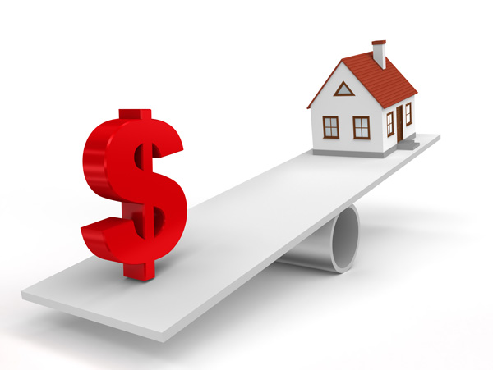
Project Presentation On “Housing: Price Prediction”
Presented By: Dr. pinki kumari sharmA

Slide 2
Agenda:
Overview.
Problem Statement.
Problem Understanding.
What is Housing Price Prediction?
Importance of housing price prediction.
Exploratory data analysis.
Visualizations.
Analysis.
Data cleaning steps.
Model Building.
Hyper Parameter Tunning.
Saving the model and predictions from saved best model.
Conclusion.

Slide 3
Overview:
In this particular presentation we will be looking on:
How to analyze the dataset of Housing Price Prediction.
What are the EDA steps in cleaning the dataset.
Overall analysis on the problem.
Model building from train dataset.
Predicting Housing Price for test dataset.

Slide 4
Problem Statement:
A US-based housing company named Surprise Housing has decided to enter the Australian market. The company uses data analytics to purchase houses at a price below their actual values and flip them at a higher price. For the same purpose, the company has collected a data set from the sale of houses in Australia. The data is provided in the CSV file below.
The company is looking at prospective properties to buy houses to enter the market. You are required to build a model using Machine Learning in order to predict the actual value of the prospective properties and decide whether to invest in them or not. For this company wants to know:
• Which variables are important to predict the price of variable?
• How do these variables describe the price of the house?

Slide 5
Problem Understanding:
House price prediction can help the developer determine the selling price of a house and can help the customer to arrange the right time to purchase a house. House Price prediction, is important to drive Real Estate efficiency. As earlier, House prices were determined by calculating the acquiring and selling price in a locality. Therefore, the House Price prediction model is very essential in filling the information gap and improve Real Estate efficiency. The aim is to predict the efficient house pricing for real estate customers with respect to their budgets and priorities. By analysing previous market trends and price ranges, and also upcoming developments future prices will be predicted. ... cost of property depending on number of attributes considered.Now as a data scientist our work is to analyse the dataset and apply our skills towards predicting house price.

Slide 6
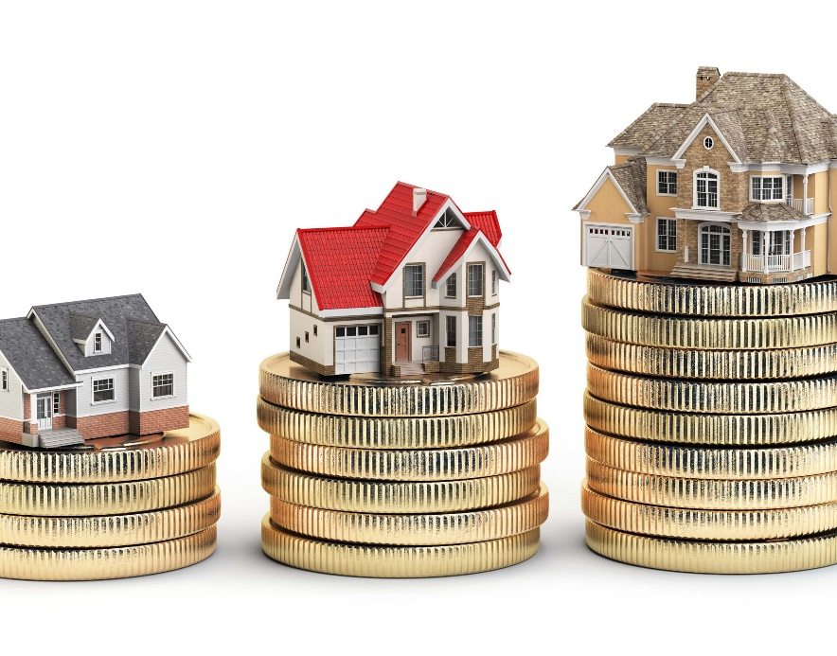
What is Housing Price Prediction?
Prediction house prices are expected to help people who plan to buy a house so they can know the price range in the future, then they can plan their finance well. In addition, house price predictions are also beneficial for property investors to know the trend of housing prices in a certain location.

Slide 7
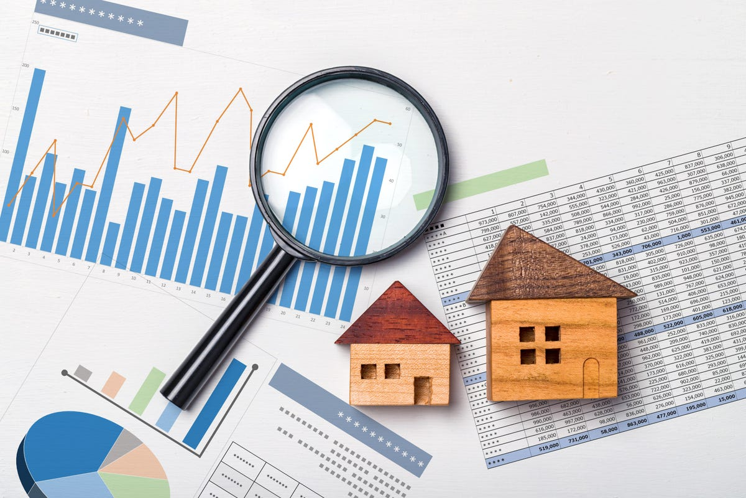
Importance of Housing Price Prediction.
House Price prediction, is important to drive Real Estate efficiency. As earlier, House prices were determined by calculating the acquiring and selling price in a locality. Therefore, the House Price prediction model is very essential in filling the information gap and improve Real Estate efficiency.

Slide 8
Exploratory Data Analysis:
As a first step I have imported required libraries and I have imported both the datasets which were in csv format.
Then I did all the statistical analysis like checking shape, nunique, value counts, info etc…..
While checking the info of the datasets I found some columns with more than 80% null values, so these columns will create skewness in datasets so I decided to drop those columns.
Then while looking into the value counts I found some columns with more than 85% zero values this also creates skewness in the model and there are chances of getting model bias so I have dropped those columns with more than 85% zero values.

Slide 9
Exploratory Data Analysis:
While checking for null values I found null values in most of the columns and I have used imputation method to replace those null values (mode for categorical column and mean for numerical columns).
In Id and Utilities column the unique counts were 1168 and 1 respectively, which means all the entries in Id column are unique and ID is the identity number given for perticular asset and all the entries in Utilities column were same so these two column will not help us in model building. So I decided to drop those columns.
Next as a part of feature extraction I converted all the year columns to there respective age. Thinking that age will help us more than year.
And all these steps were performed to both train and test datasets separately and simultaneously.

Slide 10
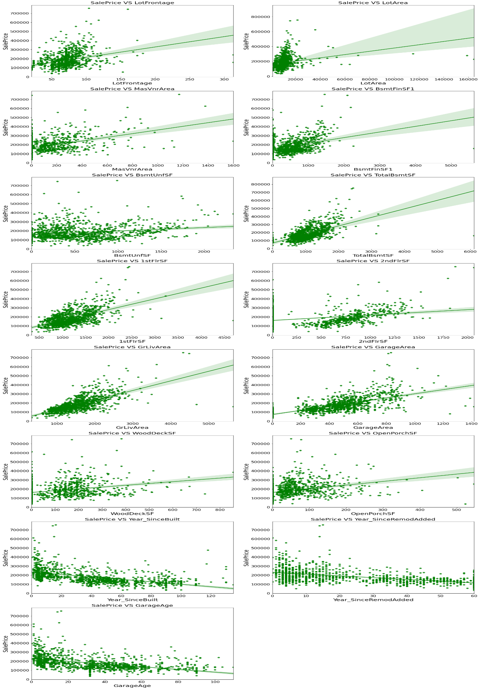
Visualization of numerical columns:

Slide 11
Observations:
As Linear feet of street connected to property(LotFrontage) is increasing sales is decreasing and the SalePrice is ranging between 0-3 lakhs.
As Lot size in square feet(LotArea) is increasing sales is decreasing and the SalePrice is in between 0-4 lakhs.
As Masonry veneer area in square feet (MasVnrArea) is increasing sales is decreasing and SalePrice is ranging between 0-4 lakhs.
As Type 1 finished square feet(BsmtFinSF1) is increasing sales is decreasing and the SalePrice is in between 0-4 lakhs.
As Unfinished square feet of basement area (BsmtUnfSF) is increasing sales is decreasing and the SalePrice is in between 0-4 lakhs. There are some outliers also.
As Total square feet of basement area (TotalBsmtSF) is increasing sales is decreasing and the SalePrice is in between 0-4 lakhs.
As First Floor square feet(1stFlrSF) is increasing sales is decreasing and the SalePrice is in between 0-4 lakhs.
As Second floor square feet(2ndFlrSF) is increasing sales is increasing in the range 500-1000 and the SalePrice is in between 0-4 lakhs.

Slide 12
Vizualization of numerical columns:

Slide 13
Observations:
As Above grade (ground) living area square feet (GrLivArea) is increasing sales is decreasing and the SalePrice is in between 0-4 lakhs.
As Size of garage in square feet(GarageArea) is increasing sales is increasing and the SalePrice is in between 0-4 lakhs.
As Wood deck area in square feet(WoodDeckSF) is increasing sales is decreasing and the SalePrice is in between 0-4 lakhs.
As Open porch area in square feet (OpenPorchSF) is increasing sales is decreasing and the SalePrice is in between 0-4 lakhs.
As Year_SinceBuilt is increasing sales is decreasing and the SalePrice is high for newly built building and the sales price is in between 0-4 lakhs.
As Since Remodel date (same as construction date if no remodeling or additions)(Year_SinceRemodAdded) is increasing sales is decreasing and the SalePrice is in between 1-4 lakhs.
As Since Year garage was built(GarageAge) is increasing sales is decreasing and the SalePrice is in between 0-4 lakhs.

Slide 14
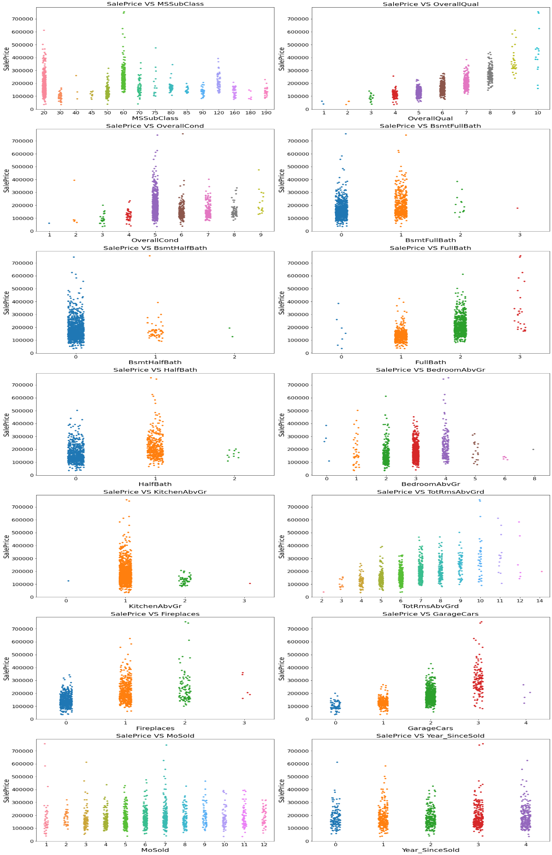
Vizualization of numerical columns:

Slide 15
Observations:
For 1-STORY 1946 & NEWER ALL STYLES (20) and 2-STORY 1946 & NEWER (60) types of dwelling (MSSuubClass) the sales is good and SalePrice is also high.
As Rates the overall material and finish of the house (OverallQual) is increasing linearly sales is also increasing And SalePrice is also increasing linearly.
For 5(Average) overall condition of the house (OverallCond) the sales is high and SalePrice is also high.
For 0 and 1 Basement full bathrooms (BsmtFullBath) the sales as well as SalePrice is high.
For 0 Basement half bathrooms (BsmtHalfBath) the sales as well as SalePrice is high.
For 1 and 2 Full bathrooms above grade (FullBath) the sales as well as SalePrice is high.

Slide 16
Vizualization of numerical columns:

Slide 17
Observations:
For 0 and 1 Half baths above grade (HalfBath) the sales as well as SalePrice is high.
For 2, 3 and 4 Bedrooms above grade (does NOT include basement bedrooms) (BedroomAbvGr) the sales as well as SalePrice is high.
For 1 Kitchens above grade (KitchenAbvGr) the sales as well as SalePrice is high.
For 4-9 Total rooms above grade (does not include bathrooms) (TotRmsAbvGrd) the sales as well as SalePrice is high.
For 0 and 1 Number of fireplaces (Fireplaces) the sales as well as SalePrice is high.
For 1 and 2 Size of garage in car capacity (GarageCars) the sales is high and for 3 Size of garage in car capacity (GarageCars) the SalePrice is high.
In between april to august for Month Sold (MoSold) the sales is good with SalePrice.
For all the Year_SinceSold the SalePrice and sales both are same.

Slide 18
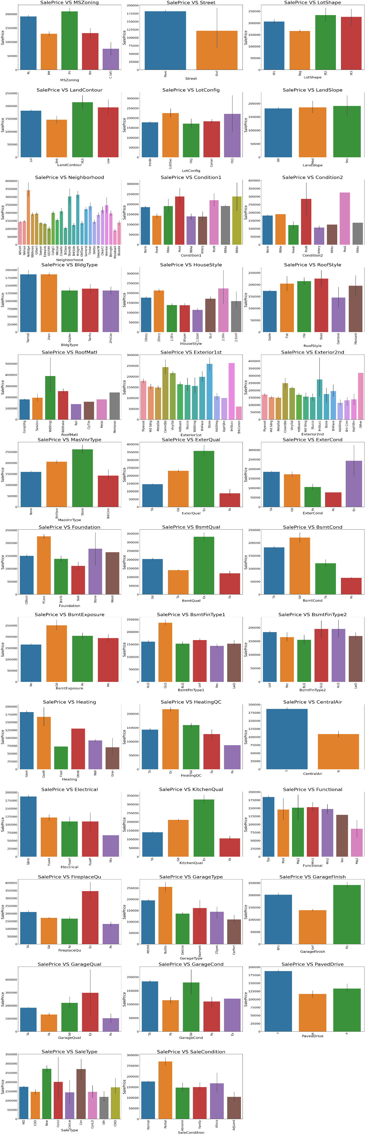
Vizualization of categorical columns:

Slide 19
Observations:
For Floating Village Residential (FV) and Residential Low Density(RL) zoning classification of the sale(MSZoning) the SalePrice is high.
For paved type of road access to property (Street) the SalePrice is high.
For Slightly irregular (IR1), Moderately Irregular (IR2) and Irregular (IR3) shape of property (LotShape) the SalePrice is high.
For Hillside - Significant slope from side to side (HLS) Flatness of the property (LandContour) the SalePrice is High.
For Cul-de-sac (CulDSac) Lot configuration (LotConfig) the SalePrice is High.
For all types of Slope of property (LandSlope) i.e., Gentle slope (Gtl), Moderate Slope (Mod) and Severe Slope (Sev) the SalePrice is High.
For Northridge (NoRidge) locations within Ames city limits (Neighborhood) the SalePrice is High.
For Within 200' of North-South Railroad (RRNn), Adjacent to postive off-site feature (PosA) and Near positive off-site feature--park, greenbelt, etc. (PosN) Proximity to various conditions(Condition1) has the maximum SalePrice.
For Adjacent to positive off-site feature (PosA) and Near positive off-site feature--park, greenbelt, etc.(PosN) Proximity to various conditions (if more than one is present) (Condition2) has maximum SalePrice.

Slide 20
Vizualization of Categorical columns:

Slide 21
Observations:
For Single-family Detached(1Fam) and Townhouse End Unit (TwnhsE) type of dwelling (BldgType) the SalePrice is high.
For 2Story and Two and one-half story: 2nd level finished(2.5Fin) Style of dwelling (HouseStyle) the SalePrice is high.
For Shed Type of roof (RoofStyle) the SalePrice is high.
For Wood Shingles (WdShngl) Roof material (RoofMat1) the SalePrice is high.
For Cement Board (CemntBd), Imitation Stucco (ImStucc) and Stone type of Exterior covering on house(Exterior1st) the SalePrice is high.
For Cement Board (CemntBd), Imitation Stucco (ImStucc) and other Exterior covering on house (if more than one material) (Exterior2) has maximum SalePrice.
For Stone Masonry veneer type (MasvnrType) the SalePrice is high.
For Excellent (Ex) quality of the material on the exterior(ExterQual) the SalePrice is high.
For Excellent (Ex) present condition of the material on the exterior (ExterCond) the SalePrice is high.

Slide 22

Vizualization of categorical columns:

Slide 23
Observations:
For Poured Contrete (PConc) Type of foundation (Foundation) the SalePrice is high.
For Excellent (100+ inches) (Ex) height of the basement (BsmtQual) the SalePrice is high.
For Good (Gd) general condition of the basement (BsmtCond) the SalePrice is high.
For Good Exposure (Gd) of walkout or garden level walls (BsmtExposure) has maximum SalePrice.
For Good Living Quarters (GLQ) of basement finished area (BsmtFinType1) has maximum SalePrice.
For Good Living Quarters (GLQ) and Average Living Quarters (ALQ) of basement finished area (if multiple types) (BsmtFinType2) has maximum SalePrice.
For Gas forced warm air furnace (GasA) and Gas hot water or steam heat (GasW) Type of heating(Heating) has high SalePrice.
For Excellent (Ex) Heating quality and condition (HeatingQC) the SalePriceis high.
For building having Central air conditioning (CentralAir) the SalePrice is high.

Slide 24
Vizualization of categorical columns:

Slide 25
Observations:
For Standard Circuit Breakers & Romex (Sbrkr) of Electrical system (Electrical) the SalePrice is Maximum.
For Excellent (Ex) Kitchen quality (KitchenQual) the SalePrice is high.
For Typical Functionality (Typ) type of Home functionality (Assume typical unless deductions are warranted) (Functional) the SalePrice is high.
For Excellent - Exceptional Masonry Fireplace (Ex) of Fireplace quality (FireplaceQual) has highest SalePrice.
For Built-In (Garage part of house - typically has room above garage) (BuiltIn) Garage location (GarageType) the SalePrice is maximum.
For Completely finished (Fin) Interior of the garage (GarageFinish) the SalePrice is high.
For Excellent (Ex) Garage quality (GarageQual) the SalePrice is high.
For Typical/Average (TA) and Good (Gd) Garage condition (GarageCond) the SalePrice is high.
For having Paved driveway (PavedDrive) the SalePriceis high.

Slide 26
Vizualization of categorical columns:
Observations:
For Home just constructed and sold (New) and Contract 15% Down payment regular terms (Con) of type of sale (SaleType) as highest SalePrice.
For Home was not completed when last assessed (associated with New Homes) (Partial) Condition of sale (SalesCondition) the SalePrice is maximum.

Slide 27
Analysis:
I have used box plot for each pair of categorical features that shows the relation with the median sale price for all the sub categories in each categorical feature.
And also for continuous numerical variables I have used reg plot to show the relationship between continuous numerical variable and target variable.
I found that there is a linear relationship between continuous numerical variable and SalePrice.

Slide 28
Data Cleaning Steps:
In my datasets I found null values, outliers and also skewness.
I have used imputation method to replace null values. To remove outliers I have used percentile method. And to remove skewness I have used yeo-johnson method.
To encode the categorical columns I have use Ordinal Encoding.
Use of Pearson’s correlation coefficient to check the correlation between dependent and independent features.
Also I have used standardization. Then followed by model building with all regression algorithms.

Slide 29
Model Building:
Since SalePrice was my target and it was a continuous column so this perticular problem was regression problem. And I have used all regression algorithms to build my model. By looking into the difference of r2 score and cross validation score I found ExtraTreesRegressor as a best model with least difference. Also to get the best model we have to run through multiple models and to avoid the confusion of overfitting we have go through cross validation. Below are the list of regression algorithms I have used in my project.
RandomForestRegressor
XGBRegressor
ExtraTreesRegressor
GradientBoostingRegressor
DecisionTreeRegressor

Slide 30
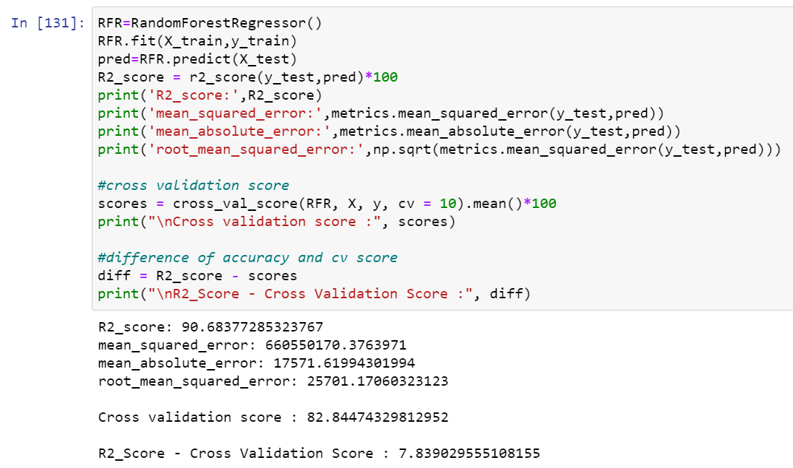
i) RandomForestRegressor:
RandomForestRegressor has given me 90.68% accuracy but still we have to look into multiple models.

Slide 31

ii) XGBRegressor:
XGBRegressor is giving me 89.32% accuracy.

Slide 32

iii) ExtraTreesRegressor:
ExtraTreeRegressor is giving me 89.66% accuracy.

Slide 33
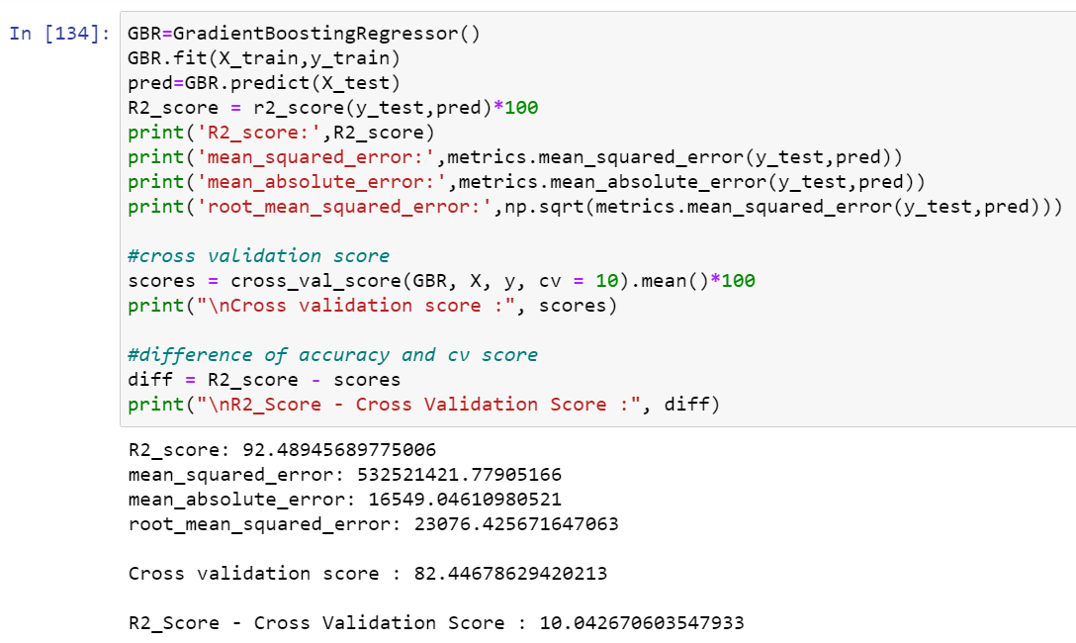
iv) GradientBoostingRegressor:
GradientBoostingRegressor is giving me 92.49% accuracy.

Slide 34
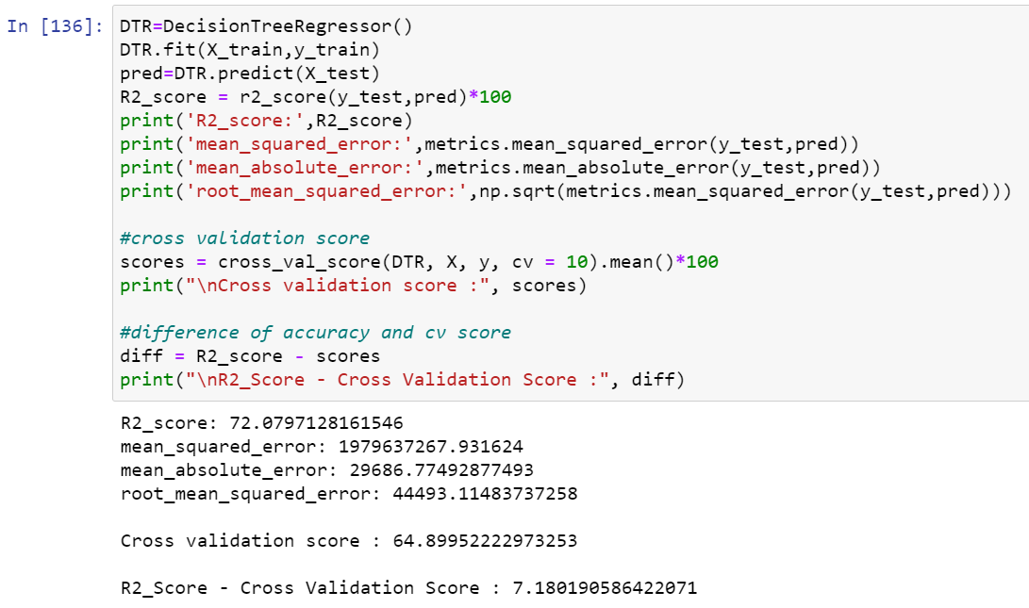
v) DecisionTreeRegressor:
DecisionTreeRegressor is giving me 72.08% accuracy.
By looking into the difference of model accuracy and cross validation score I found ExtraTreesRegressor as the best model.

Slide 35
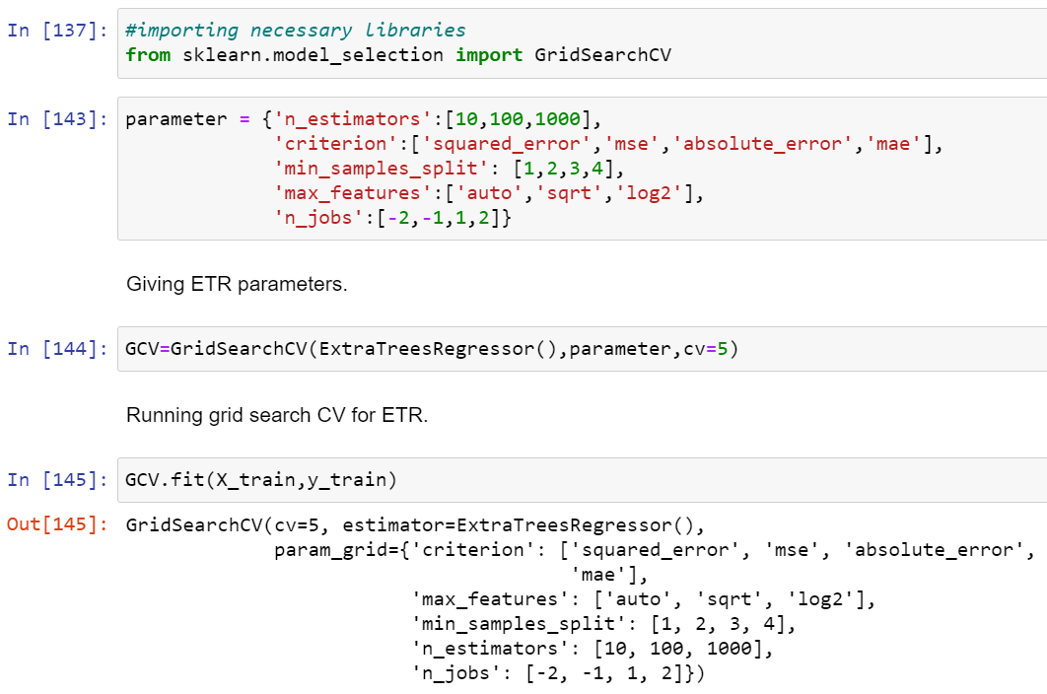
Hyper Parameter Tunning:

Slide 36
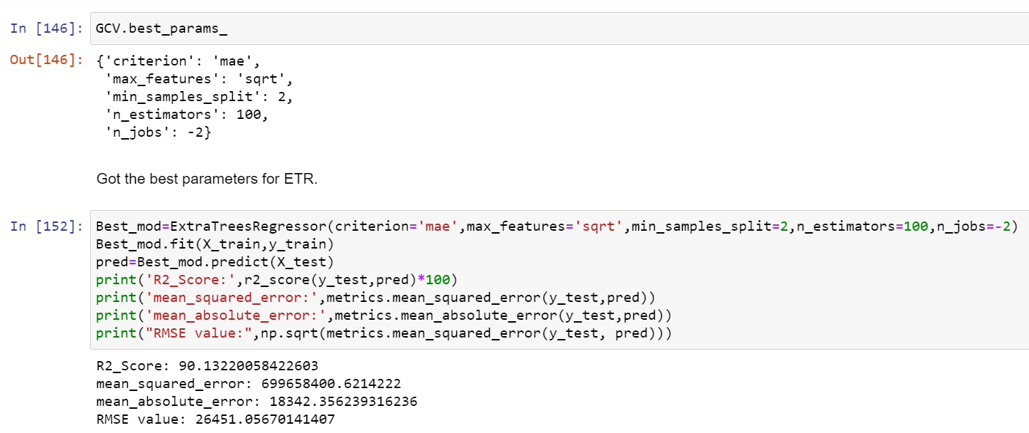
Hyper Parameter Tunning:
I have choosed all parameters of ExtraTreesRegressor, after tunning the model with best parameters I have incresed my model accuracy from 89.66% to 90.13%. Also mse and rmse values has reduced which means error has reduced.

Slide 37
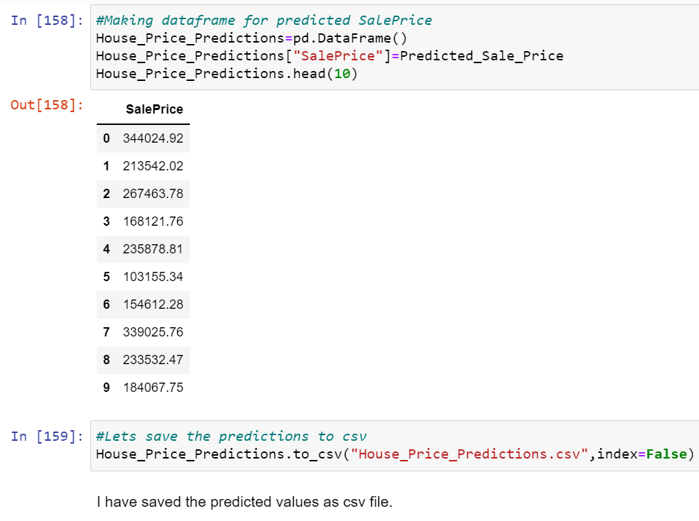
Saving the model and predictions using saved model:
I have saved my best model using .pkl as follows.
Now after saving the best model, loading my saved model and predicting the test values.
I have predicted the SalePrice for test dataset using saved model of train dataset, and the predictions look good. I have also saved my predictions for further analysis.

Slide 38
Conclusion:
In this project report, we have used machine learning algorithms to predict the house prices.
We have mentioned the step by step procedure to analyze the dataset and finding the correlation between the featuers. Thus we can select the features which are not correlated to each other and are independent in nature.
Those feature sets were then given as an input to five algorithms and a csv file was generated consisting of predicted house prices.
Hence we calculated the performance of each model using different performance metrics and compared them based on these metrics. Then we have also saved the dataframe of predicted prices of test dataset.
To conclude, the application of machine learning in property research is still at an early stage. We hope this study has moved a small step ahead in providing some methodological and empirical contributions to property appraisal, and presenting an alternative approach to the valuation of housing prices.
Future direction of research may consider incorporating additional property transaction data from a larger geographical location with more features, or analysing other property types beyond housing development.

Slide 39


